Slide 1
Analytics Project Presentation - Fall 2014
NYU Real Time and Big Data
Project : Rodent Baiting in NYC.
Team: Sanchit Khandelwal, Rohit Shankar, Simran Kaur.

Slide 2
Rodent Baiting in NYC.
Abstract
Analytic 1
To find the factor which can be best used to predict the occurrence of Rodents in a particular area.
Using Garbage, Water Leaks complaints with Rodent complaints to find the if there is an increase in Rodent complaints.
Analytic 2
Analyze the frequency of rodent complaints made in the city with respect to temperature ranges since 2012
Analytic 3
To estimate the rat population of the city. 8 million rats for 8 million New Yorkers? Debunk the myth ?

Slide 3
Rodent Baiting in NYC.
Background
NYC- infamous for its rodent problem.
311-non emergency helpline to provide access to different government services.
Takes requests in the form of complaints. Tracks and Manages complaints.
311 complaints database updated daily and open source.
New York City Department of Health and Mental Hygiene (DHMH)

Slide 4
Rodent Baiting in NYC.
Motivation
The aforementioned rodent problem.
DHMH does not take well planned preemptive actions to control rodent population.
First come first serve basis problem solving.
No official estimate of no. of rodents.
DHMH can use our analytic to take preemptive actions which can help reduce /control the no. of rodents.

Slide 5
Rodent Baiting in NYC.
Data Sources
<311 Rodent Complaint Database>
Contains rodent complaints with details like timestamp of complaint, zip code, location type etc. for year 2010- Nov ’14.
Size: 38MB; Format: ‘.CSV’
<311 Sanitation Complaint Database>
Contains sanitation complaints having fields similar to rodent database for 2010-Nov’14.
Size: 41MB; Format: ‘.CSV’
<311 Water Leak Database>
Contains several water complaints like water leaking, standing water, hydrant overflow along with timestamp, zip code etc. for 2010-Nov’14.
Size: 30MB; Format: ‘.CSV’

Slide 6
Rodent Baiting in NYC.
Data Sources Contd.
<NCDC Weather Database>
The National Climate Data Center (NCDC) weather database for NYC contains fields like max, min temp, rainfall, wind speeds for each day for years 2012-Nov’2014.
Size:1MB; Format: ‘.CSV’
Analytic 1: Sanitation, Water Factor
Design Diagram:

Slide 7
Figure 1: Sanitation/Water leak
‘311 Rodent complaints’ database
‘311 Sanitation complaints’ database
Data cleanup: Extract {date,zipcode} fields
Data cleanup: Extract {date ,zipcode} fields
PIG: Join operation to get for each sanitation date all rodent dates along with zipcodes (area)
MR1: For each sanitation date get count of no. of rodent complaints ,1 week prior(negative) and 1 week (positive)after the sanitation date, along with zipcodes (area)
MR2: Get Average no of negative and positive rodent complaints for each ZipCode(area)
Analysis of results

Slide 8
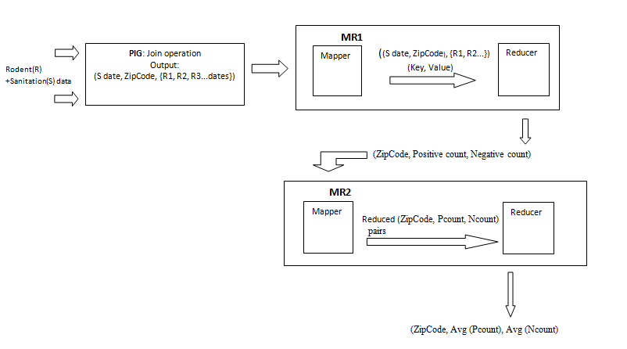
Data Flow Diagram Figure 2: Input and Outputs in each Stage using Cloudera VMware

Slide 9
Result
Areas where, when a sanitation complaint is received, preemptive rodent control action should be taken .

Slide 10
Result
Areas where sanitation is not the cause for a rodent complaint

Slide 11
Result
In almost all cases number of rodent complaints a week after a sanitation complaint is more than the rodent complaints a week before

Slide 12
Result
Areas where, when a water leak complaint is received, preemptive rodent control action should be taken

Slide 13
Result
Areas where a water leak is not the prime cause for a rodent complaint; other factors are more dominant.

Slide 14
Result
In most cases number of rodent complaints a week after a water leak complaint is more than the rodent complaints a week before

Slide 15
Rodent Baiting in NYC.
Analytic 2: Weather affecting rodent complaints
Aim to find Rodent complaints and temperature relation.
Design Diagram:

Slide 16
Figure 3: Weather Analytic
NCDC Weather database for NYC, 2012-14
311 Rodent Complaints database
Data Cleanup and date formatting
Data Cleanup and extracting 2012-14 data only.
Individual temperature values replaced by 5⁰C interval Ranges.
MR1:Date formatting
PIG: Inner Join to get temperature range for each rodent complaint date
MR2: Aggregation of complaints based on temperature ranges.
Analysis of results

Slide 17
Result
1)As NYC experiences moderate temperature [15 – 25 C] the number of rodent complaints increase.

Slide 18
2) Results analogous to scientific finding
3) When we move from summer to winter ((30-25)->(10-5)) Rodent complaints increase. Because rodents move indoors. Preemptive measure when fall ends and winter starts.
Analytic 3: Estimation of Rodent Population
Design Diagram:

Slide 19
311 Rodent Complaint Database for 5 years (2010-14)
Calculate Avg. no of complaints each year=>Total no of complaints /5. Assuming one rat lives 1 year.
PIG: Calculating rodent complaints for each zipcode for each year.
Multiply the Avg. by 50. Each colony of rat has around 50 rats. Assuming Each complaint is for different colony
Analysis of result
OutPut:
Overestimate of the number of rats in NYC

Slide 23
Rodent Baiting in NYC.
Analysis of Results for Estimation of Rodent Population:
Scientific studies have shown that life expectancy of a rodent is 1 year in a city.
Hence we found Avg. no rodent complaints for 1 year
Taking the big overestimation-each rodent call represents each entire colony (on an avg. rodents live in a colony of 40-50)
We Get approx.1.2million
Sewer population(not that much)+ 1.2million = approx. 2 million. A very good Overestimation.
Which is still less than 8 Million. Urban myth debunked.

Slide 24
Rodent Baiting in NYC.
Obstacles
Change of analytic project- no access to College data.
NYC HPC Cluster – Encountered several problems and had to start over using Cloudera VM
Each database had a date format that was entirely different from the other (sometimes even within a database)

Slide 25
Rodent Baiting in NYC.
Conclusion
Sanitation and Water leakage are a cause for increase in rodents in 85% of the NYC areas.
Rodents increase between 65F -90F, which conforms to scientific findings.
3) Urban Theory “8 million rats for 8 million people” debunked.
Acknowledgements
NCDC for providing us with the weather database for NYC
311 service of NYC for putting up their extensive databases online
Prof. Suzanne Macintosh for her guidance and support during the course of this project

Slide 26
Rodent Baiting in NYC.
References
[1] http://www.statetechmagazine.com/article/2014/11/chicago-leverages-311-and-big-data-tackle-its-rat-problems
[2] New York Department of sanitation: Spatial Analysis Of Complaints. Sarah Williams, Nick Klien
[3]http://www.health.ny.gov/statistics/cancer/registry/appendix/neighborhoods.htm
[4] Planning Rodent Control For Boston’s Central Artery/Tunnel Project. Bruce Colvin, A.Daniel AShton,Wellard McCartney, William Jackson

Slide 27
Rodent Baiting in NYC.
Thank you!

